Slide 1
Building a Data Mesh Architecture in Azure
Data Mesh vs Azure (Theory vs Practice)

Slide 2
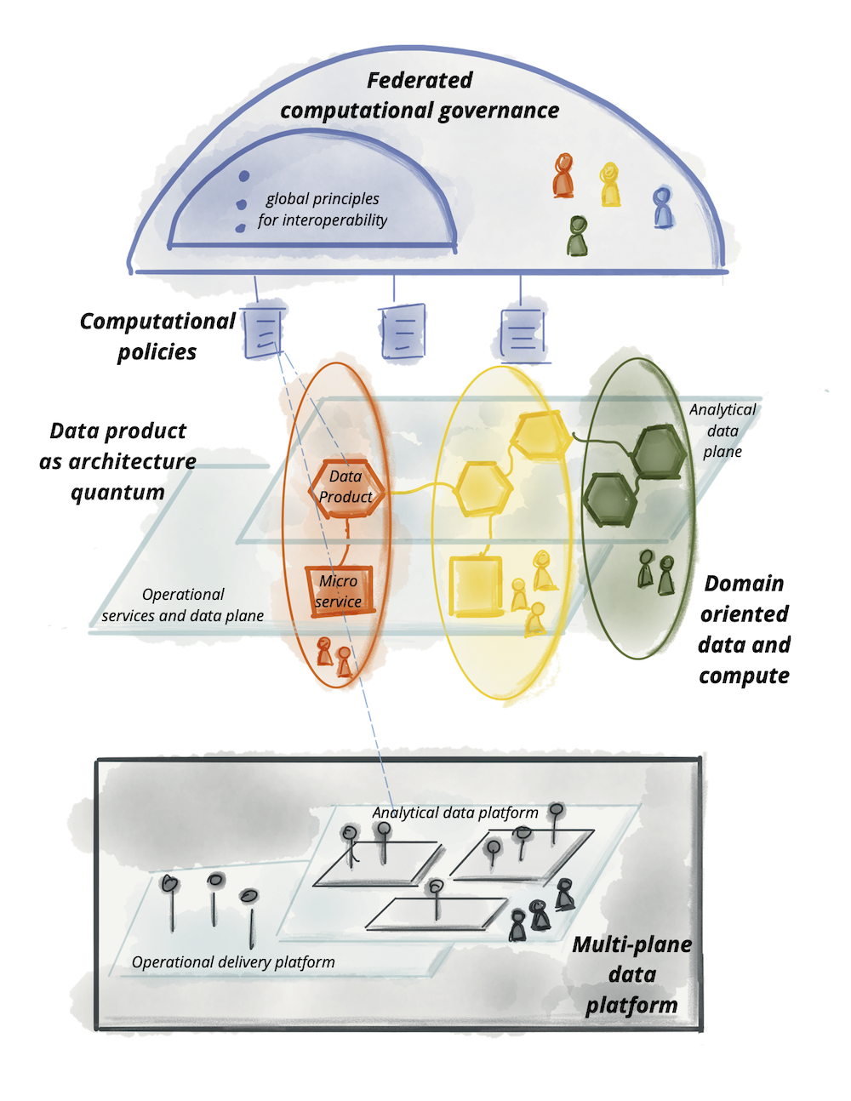
Data Mesh vs Azure – Part 1
Theory vs Practice
Image Source: https://martinfowler.com/articles/data-mesh-principles.html

Slide 3
Data Mesh vs Azure – Part 2
Theory vs Practice

Slide 4
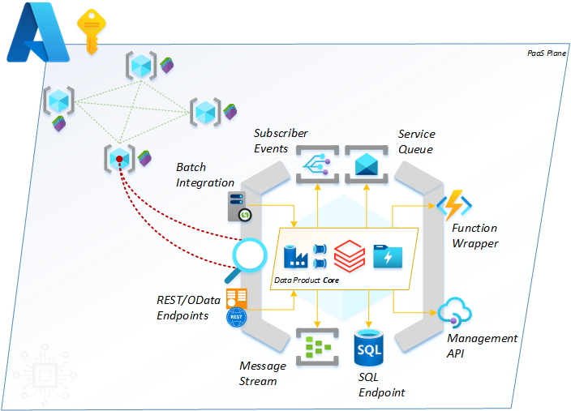
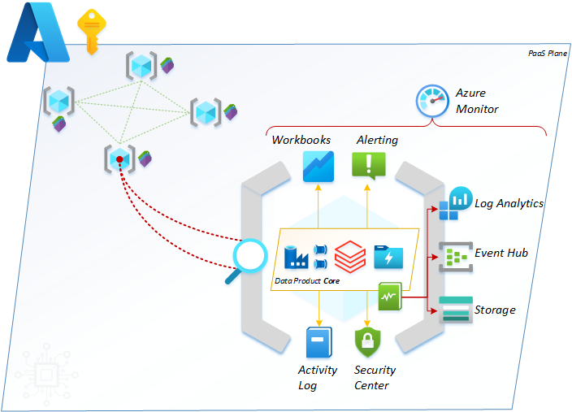
Data Mesh vs Azure – Part 3
Theory vs Practice
Secondary Interfaces - operational reporting and logging.
Primary Interfaces – data integration and exchange.
Tertiary Interfaces - resource connectivity.

Slide 5

Data Mesh vs Azure – Part 4
Theory vs Practice
Blog contributions and wisdom from
Mr Rob Sewell (@sqldbawithbeard).

Slide 6
Data Mesh vs Azure – Part 5
Theory vs Practice
Data Mesh – Domains vs Products
A hierarchy of scale:

Slide 7
Data Mesh vs Azure – Part 6
Theory vs Practice

Slide 8
Data Mesh vs Azure – Part 7
Theory vs Practice
A Mesh Marketplace
A Self-Service Analytics Canvas
An Onboarding Framework

Slide 9
Data Mesh vs Azure
Defining a Data Product
Domain Driven
Data Required
Technically Capable
Revenue Generating
Supplementary
Governance Aligned
Accurate
Meaningful
Necessary
Accessible
Connected
Modelled
Timely
Deployable

Slide 10
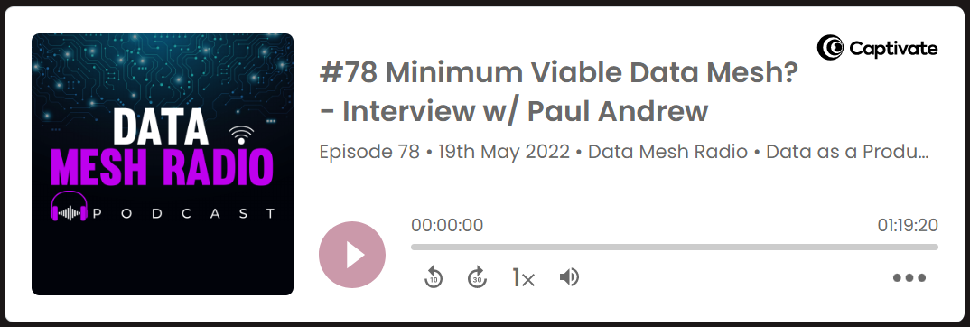

Data Mesh vs Azure
Data Mesh Radio Podcast
#78 A Minimum Viable Data Mesh?
https://daappod.com/data-mesh-radio/

Slide 11
Data Mesh vs Azure – Part 10
Data Products NOT Data Pretenders
Domain Driven
Some
Data Required
Maybe
Technically Capable
Not Really

Slide 12


Data Mesh vs Azure – Part 11
Kasper on BI Podcast
#Data Mesh – Let’s Recap
What
Why
How
https://www.youtube.com/c/KasperOnBI

Slide 13
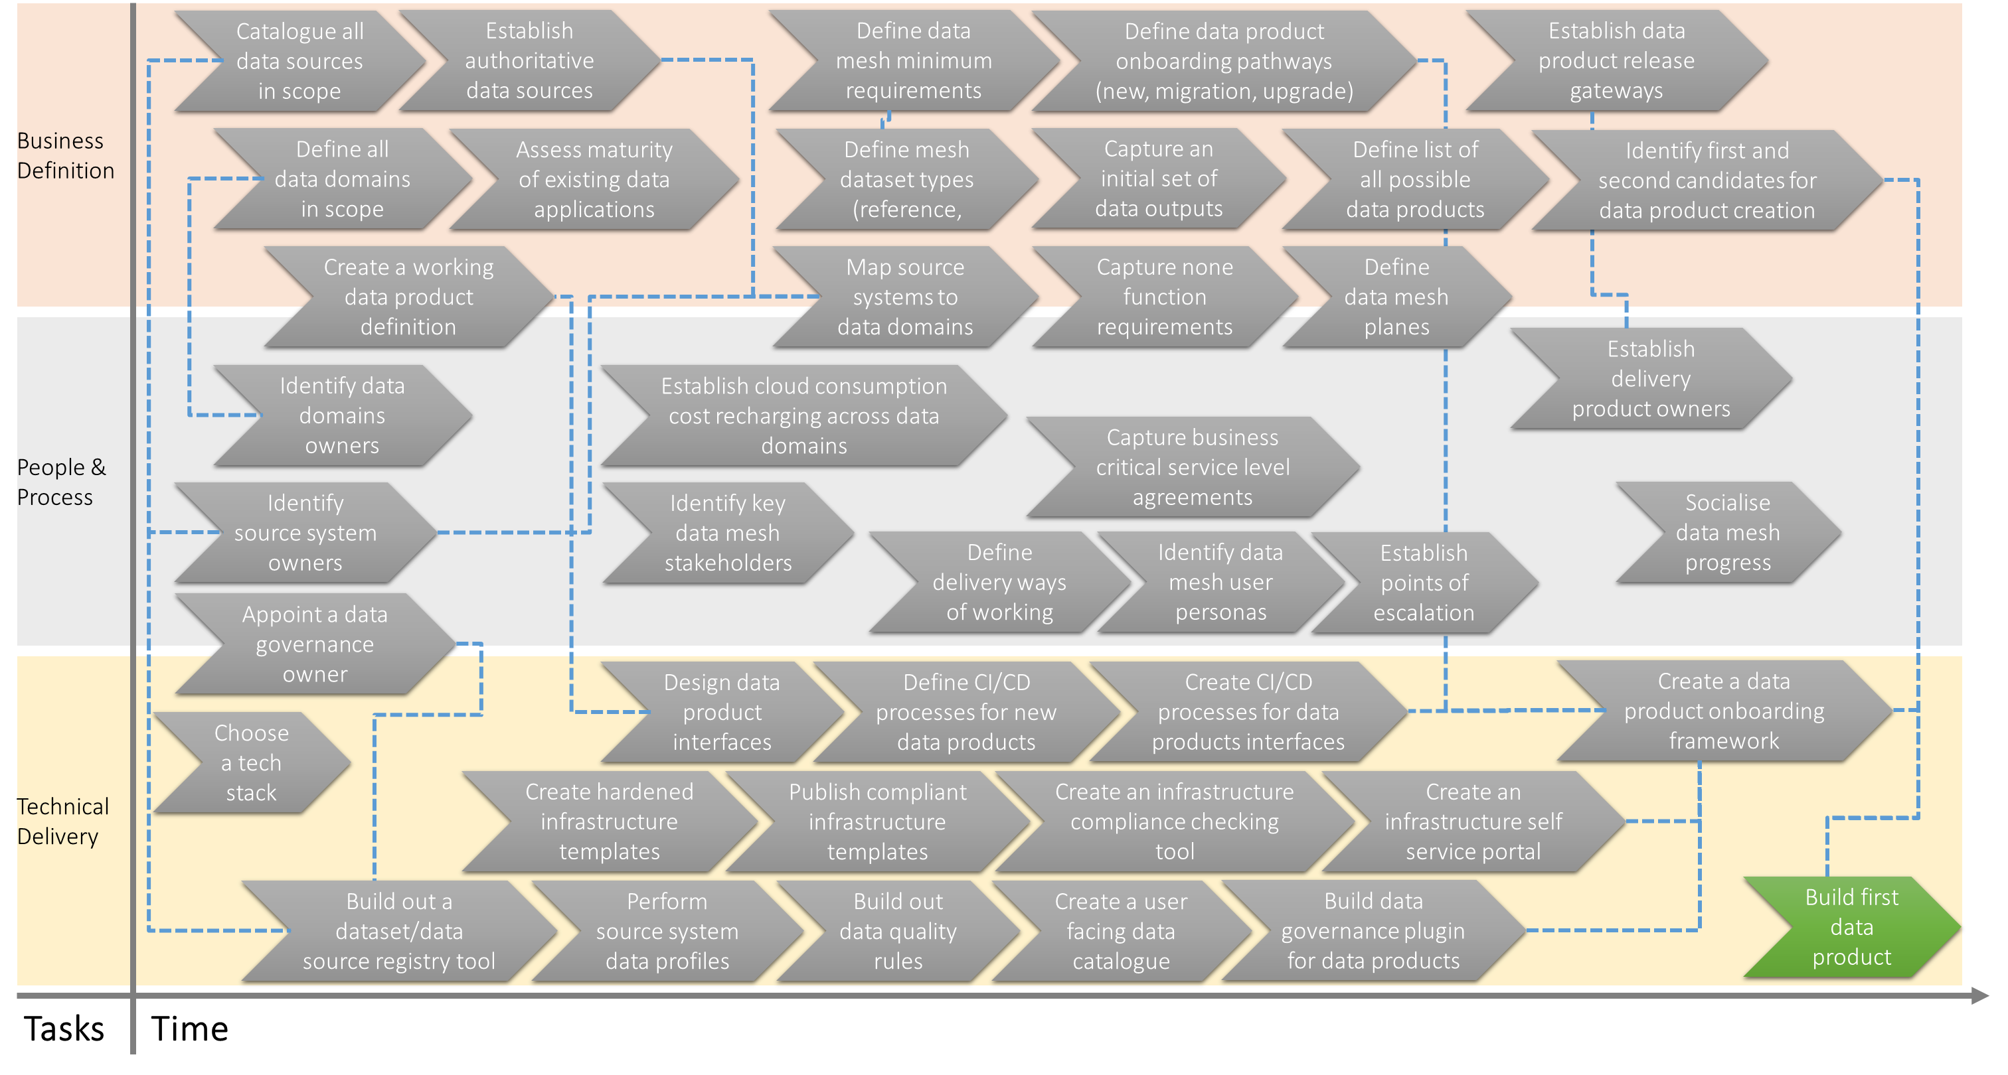
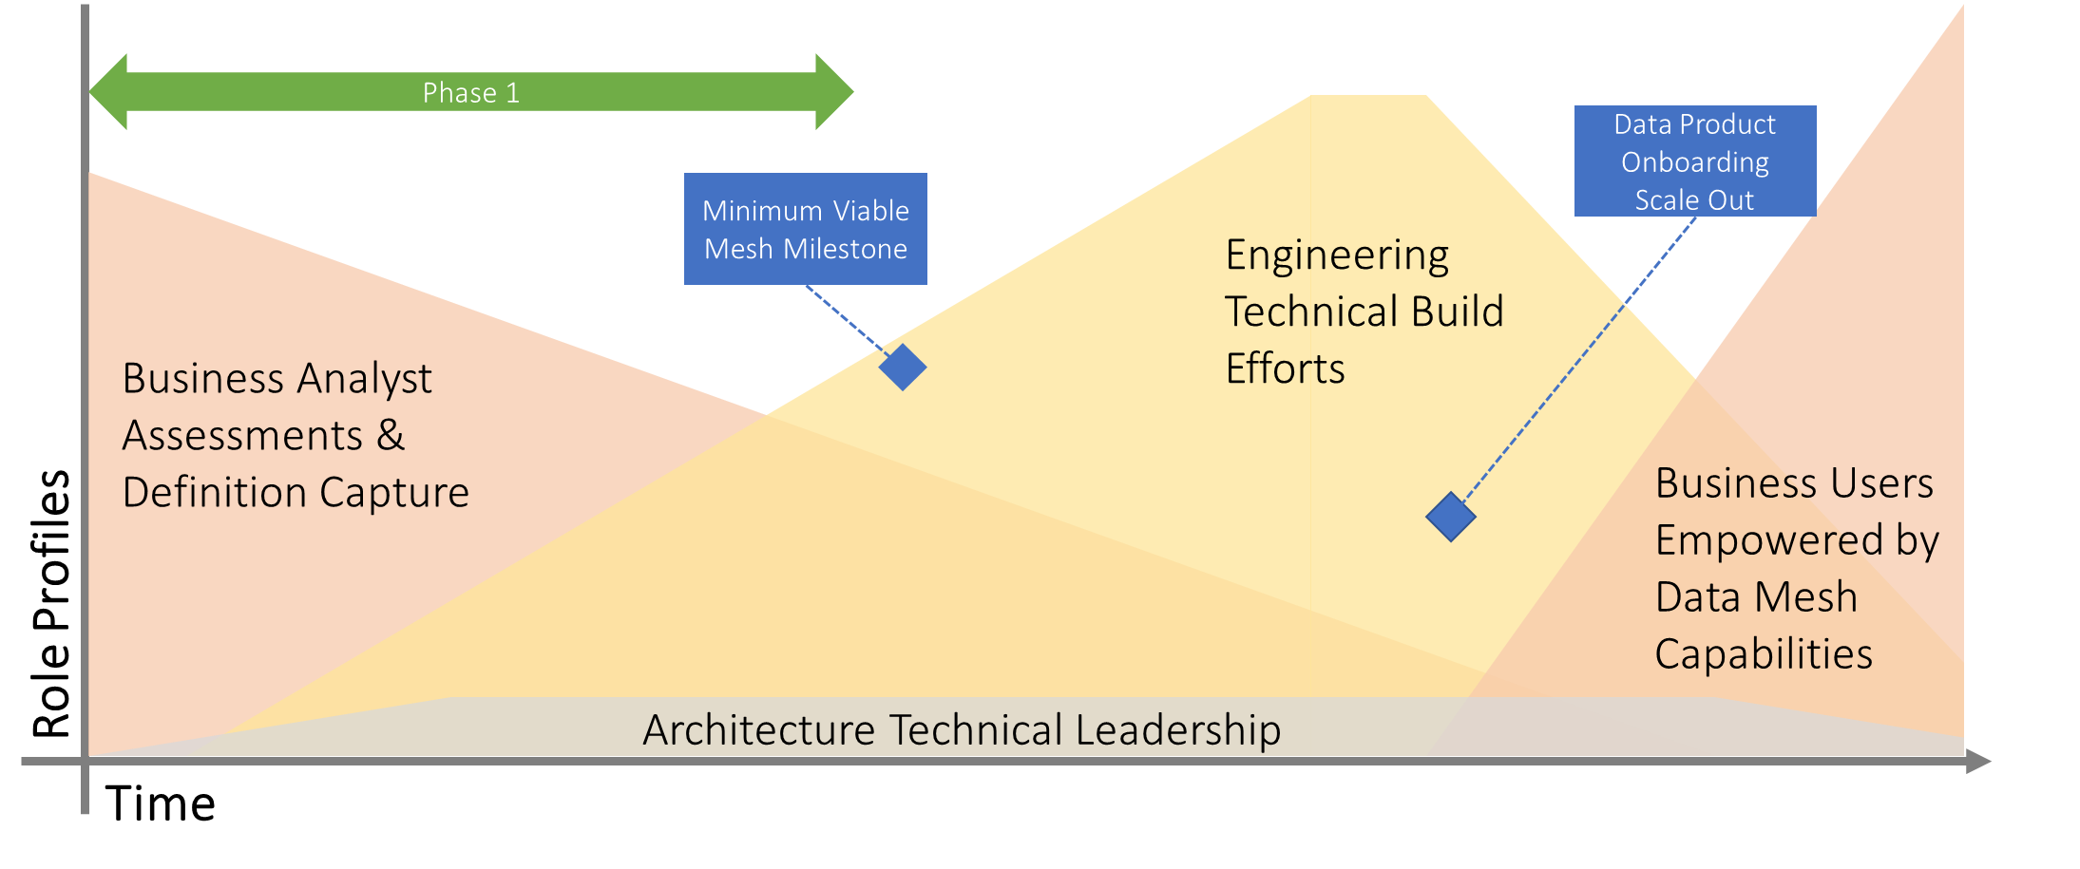
Data Mesh vs Azure – Part 12
Where to start – delivery roadmap

Slide 14
Data Mesh Roadmap - Starting Point
Business
Definition
Catalogue all data sources in scope
Establish authoritative data sources
Define data mesh minimum requirements
Define data product onboarding pathways (new, migration, upgrade)
Establish data product release gateways
Define all data domains in scope
Assess maturity of existing data applications
Define mesh dataset types (reference,
Capture an initial set of data outputs
Define list of all possible data products
Identify first and second candidates for data product creation
Create a working data product definition
Map source systems to data domains
Capture none function requirements
Define data mesh planes
People &
Process
Establish delivery product owners
Identify data domains owners
Establish cloud consumption cost recharging across data domains
Capture business critical service level agreements
Identify source system owners
Identify key data mesh stakeholders
Socialise data mesh progress
Define delivery ways of working
Identify data mesh user personas
Establish points of escalation
Appoint a data governance owner
Technical
Delivery
Design data product interfaces
Define CI/CD processes for new data products
Create CI/CD processes for data products interfaces
Create a data product onboarding framework
Choose a tech stack
Create hardened infrastructure templates
Publish compliant infrastructure templates
Create an infrastructure compliance checking tool
Create an infrastructure self service portal
Build out a dataset/data source registry tool
Perform source system data profiles
Build out data quality rules
Create a user facing data catalogue
Build data governance plugin for data products
Build first data product
Tasks
Time

Slide 15
Phase 1
Data Product Onboarding Scale Out
Minimum Viable Mesh Milestone
Engineering Technical Build Efforts
Business Analyst Assessments & Definition Capture
Role Profiles
Business Users Empowered by Data Mesh Capabilities
Architecture Technical Leadership
Time

